Slide 1
Undergraduate Research
Participant Pool (URPP)
Summer 2016

Slide 2
What is the URPP?
Earn 4% of your final PSYC 1010 grade by participating in psychology research
6 research hours in the Summer term
(May 9-Aug 9)
4% of your final grade
Notes:
The URPP allows you to earn 4% out of 100% of your final PSYC 1010 grade by participating in psychology research that is going on here at York University. So throughout the term you’ll be able to participate in interesting research! This is a fun easy and interesting way to earn 4 % of your psych 1010 grade.
If you participate in 6 hours of research during the summer term You will earn 4% toward your final grade.
This 4% is very valuable, and it is often enough to boost you up a letter grade!
One thing that I’d like to stress is that we recommend that you start early. There will be enough credits offered during the summer term to allow all students enrolled in PSYC 1010 to fulfill the quota, but we recommend that you start earning credits early, and don’t leave things to the end of the term.

Slide 3
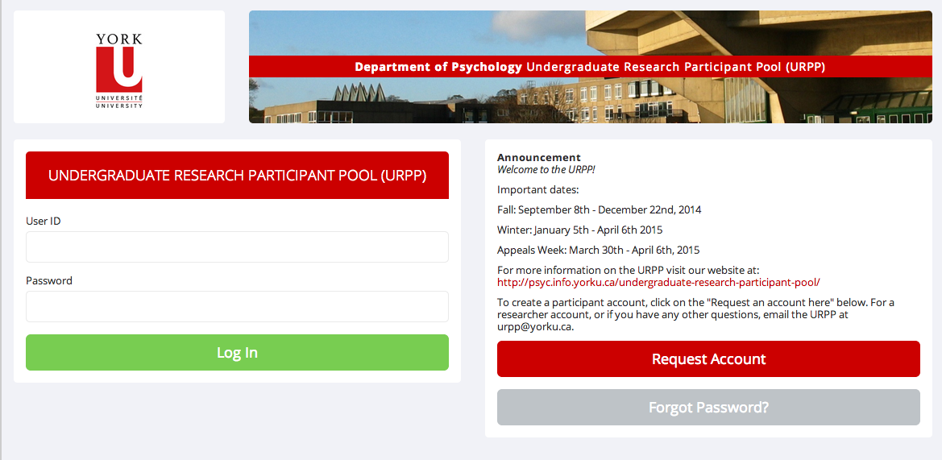
How do I start?
Go to the URPP website (http://yorku.sona-systems.com) and create a new account.
Notes:
To get started, you need to create a URPP account. Go to http://yorku.sona-systems.com, this is listed on your handout, and follow the links to create a new account.
(can also google yorku urpp – will get either the department website, or this website)
You click on ‘New participant?’ To request an account
Once you create your account, it may take up to three days to receive your login information by email. It does not arrive immediately. If 3 days have passed and you have not received your login information, email us and we can look into it. Keep in mind that the login information may also be filtered to your spam box, so you should also check there.

Slide 4
Remember!!!
Use a York email address
Check account regularly
Enter your student number and course section correctly
Write down your URPP identity code
Notes:
When asked to provide an email address we recommend that you use your yorku email address or else notifications sent to you (including your password) are more likely to end up in a spam/junk folder. Some other email accounts do not work well with the sona system. What is most important is that you use an email account that you check regularly, and if it is not a yorku account, be sure to check your spam folder.
It is critical that you enter your student number and your course section correctly or else you may not get credit for your research participation. This is not monitored by anyone other than you, so double check that it is correct.
When you create your account you will be given a 6 digit numeric code. This is you URPP ID code and it will be emailed to you. This is how the researchers will identify you. Write this code down and bring it with you to every study that you participate in.

Slide 5
How do I participate in studies?
Complete the prescreen questionnaire
demographic questions
E.g., Do you speak more than 1 language?
1 “credit” for each hour of participation. A half hour study would be worth ½ a credit.
You need to earn a total of 6 credits (6 hours) prior to August 9th to get your full 4%.
Each ½ credit = .33%
Warning: Do not wait until the last minute to earn your credits.
Notes:
After you create an account you will be able to complete the prescreen questionnaire.
It will ask you a series of questions about your personal characteristics. All of your responses will be kept confidential. Importantly, although completing the prescreen is voluntary, if you do not complete the pre screen questionnaire, you will have access to fewer studies.
For example, the prescreen may ask you if you are bilingual, or if you have musical training. So we recommend that you complete the pre screen questionnaire.
After you create and account and complete the pre screen you will see a list of studies that you can participate in. You can browse these and pick the ones that you find interesting and fit with your schedule.
You receive 1 credit for every hour of research you participate in. So a study that takes an hour to complete will give you 1 credit, and a study that is a half an hour long will give you half of a credit.
You will need to complete 6 credits by Aug 9th to receive the full 4%.
There will be online studies as well as in lab studies. Most of the in lab studies take place in buildings like the behavioral sciences buidlings – but the location will also be displayed on the system where you sign up.
We recommend that you participate in at least one in-lab study. It offers you a different experience. You’ll get to see first hand how the research that you’re reading about is actually carried out.
There is a lot of really interesting research happening here at York. Some labs use neuroimaging and I believe you might even get to keep a picture of your brain, there are some labs that use driving simulators, eye trackers that monitor your eye gaze, or even video games.
So again I’d like to stress that you really shouldn’t leave earning your credits until the last minute --- the interesting studies fill up fast, and if you leave it to the end of the term, there is no guarantee that you can get your full 4%.
But, you can earn partial credit – if you do begin late, do still participate – you can earn partial credit, you get .33% per half credit.

Slide 6
Second Time Around?
You cannot transfer credits from a previous course.
If you have already taken PSYC1010 and are doing it for a second time, you need to earn 6 new credits for this course.
Email the URPP to reactivate your account
Within the same term, can switch between sections
Notes:
If you have already taken PSYC 1010 you have to earn 6 new credits for this course
please email us so that we can reset your account. Your old account would have been deactivated when the winter semester ended.
If you change sections during the summer term– or if you realize that you put the wrong section in your account profile, you can change this up until the URPP closes at the end of the term.

Slide 7
Code of Conduct
Show up on time . If you cannot attend your appointment, cancel it.
Penalties for missed studies
Check your account regularly. Keep confirmation emails and hard copies from lab studies.
August 3rd – August 9th = Appeals week
Notes:
Signing up for a study is like signing a contract. You must show up on time for research appointments. If you show up late, you may be rescheduled, but you may not, its up to the discretion of the researcher.
What's important, is that if you can’t make it to an appointment, you must cancel it. You can cancel the appointment using the online system up to 24 hours before the appointment.
If you have to cancel the appointment on the day of -- you have to contact the researcher directly. Their email address will be in the study confirmation email or on the system where you signed up for the study.
If you miss the appointment without emailing the researcher in advance -- they will penalize you. So you ‘ll have to earn additional credits to make up for the ones you lost by not cancelling the appointment.
Right to Withdraw: As part of ethical research procedures, a participant has the right to withdraw at any time during the course of a study without penalty. If you feel uncomfortable for whatever reason about continuing in a study once you've begun, let the researcher know.
Record Keeping: All records are kept online and mistakes can occur. Keep an eye on your account to make sure your credits are all there. Keep the confirmation emails that you receive after you participate. Keep in mind it can take up to 72 hours for credits to appear on your account. If you do not see your credit after 72 hours, contact the researcher directly.
Appeals week is from August 3rd – August 9th Double check your credits during this time, and if you’re missing credits for a study– email the researcher in charge of the study. If there are further problems, email the URPP office before August 9th.
After appeals week ends on August 9th, the marks are finalized with the instructors.

Slide 8
Is there another way to earn my 4%?
Paper Stream
Write a 3-page paper summarizing and critiquing a psychology research article
If you wish to choose this Paper Stream you must email us before May 29th, 2016
Notes:
If you do not wish to participate in research you have the option of joining the paper stream.
So you can opt to write a 3 page paper summarizing a psychology research article that will be assigned to you. This is a full length scholarly article.
Your paper will be graded and acceptable papers will earn up to 4% toward their final grade.
If you want to opt in to the paper stream you must email the URPP office before May 29th.
We do not accept late entries into the paper stream so it is important to consider now whether the paper stream is right for you. Think about your schedule. If you think you may not be able to find time to participate in research, even online, consider the paper stream.

Slide 9
Important Dates
Summer Term start date: May 9th , 2016
Summer Term end date: August 9th , 2016
Credit Appeals week: August 3rd – August 9th, 2016
Paper Stream deadline: May 29th, 2016
Notes:
So this is just a review of the important dates for the URPP. They are all listed on the handout.

Slide 10
Where do I go for more information?
Department URPP Site: http://psyc.info.yorku.ca/undergraduate-research-participant-pool/
Student Manual
Frequently Asked Questions
About research at York: https://www.youtube.com/watch?v=ZfanmoLvsSQ&feature=youtu.be
Video system manual: https://www.youtube.com/watch?v=_1OnT2ZU6QQ
If you have any questions: urpp@yorku.ca
Notes:
If you have any questions during the term or if any issues arise, please email us at urpp@yorku.ca.
You will get a response within 2 business days
There is also a link to FAQs on the handout…but again you can get there by googling YorkU URPP
Are there any questions?

