Slide 1
Undergraduate Research
Participant Pool (URPP)
Winter 2016
Notes:
Hey everyone! My name is _____ and I’m a graduate student in psychology. I’m also one of the URPP coordinators.
A lot of what students and profs do at York is research. I conduct research for my graduate studies and many of you will conduct research in your third and fourth years for theses and independent studies. York has a vibrant research community.
One of the main ways researchers at York find researcher participants is through the Undergraduate Research Participant Pool (URPP). Yes, U R P P…

Slide 2
What is the URPP?
Earn 4% of your final PSYC 1010 grade by participating in psychology research
6 hours in the Winter term
(Jan 3 – Apr 4)
4% of your final grade
Notes:
You earn 4% toward your final grade by participating in 6 hours of research during the winter term.
Important: You must do 3 hours of research per term. You cannot do all of your hours in one term. If you earn more than 3 credits in the fall, you will only get credit for the first three, and you cant just leave all 6 to do in the winter.
Enough credits are offered throughout the term year that all students enrolled in psyc1010 can fulfill their credit quota – but we recommend that you start earning credits early, and don’t leave things until the end of the term

Slide 3
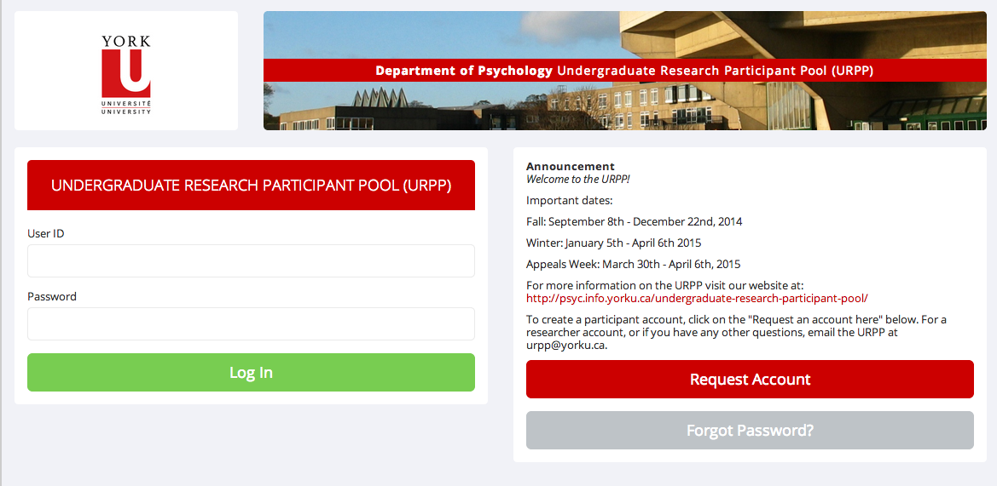
How do I start?
Go to the URPP website (http://yorku.sona-systems.com) and create a new account.
Notes:
To get started, you need to create a URPP account. Go to http://yorku.sona-systems.com, and follow the links to create a new account. (can also google yorku upp – will get either the department website, or this website)
You click on ‘New participant?’ To request an account
Once you create your account, it may take up to three days to receive your login information by email. It does not arrive immediately. If 3 days have passed and you have not received your login information, email us and we can look into it. Keep in mind that the login information may also be filtered to your spam box, so check there too.

Slide 4
Remember!!!
Use a York email address
Check account regularly
Enter your student number and course section correctly
Write down your URPP identity code
Notes:
When asked to provide an email address we recommend that you use your yorku email address or else notifications sent to you (including your password) are more likely to end up in a spam/junk folder. What ever email you choose to use, be sure you check it regularly, as we send out important notifications throughout the term.
It is critical that you enter your student number and your course section correctly or else you may not get credit for your research participation. This is not monitored by anyone other than you, so double check that it is correct.
When you create your account you will be given a 6 digit numeric code. This is you URPP ID code and it will be emailed to you. This is how the researchers will identify you. You need to know this code to participate in studies, so when you receive it write it down or better yet make a note in your smartphone with it so that you’ll have it hand at a study if you are asked for it.

Slide 5
How do I participate in studies?
Complete the prescreen questionnaire
Especially demographic questions - last digit of student number, gender etc.
1 “credit” for each hour of participation. A half hour study would be worth ½ a credit.
Warning: Do not wait until the last minute to earn your credits.

Slide 6
Code of Conduct
Show up on time . If you cannot attend your appointment, cancel it.
Penalties for missed studies
Check your account regularly. Keep confirmation emails and hard copies from lab studies.
March 28th – April 4th : Appeals week
Notes:
Code of Conduct: Researchers and participants must show up on time for research appointments. Signing up for a study is like signing a contract. If you show up late, the researcher will decide whether there is enough time to complete the study. If not, your appointment may be cancelled or rescheduled at the researcher's discretion.
If you miss an appointment without contacting the researcher you will be required to complete extra hours to earn your 4%. This means that if you sign up for a 2 credit study and you miss the appointment without cancelling, not only do you not earn 2 credits, but you will lose 2 credits.
This can easily be avoided by cancelling online up to 24 hours in advance; the web system will not allow any cancellations made less than 24 hours before your appointment. Be sure to take note of the researcher’s phone number and email address when you sign up, in case you are unable to attend your appointment on short notice and need to contact them by phone or email.
Right to Withdraw: As part of ethical research procedures, a participant has the right to withdraw at any time during the course of a study without penalty. If you feel uncomfortable for whatever reason about continuing in a study once you've begun, let the researcher know.
Record Keeping: All records are kept online and mistakes can occur. It’s important to monitor your account to make sure your credit record is accurate. We recommend keeping the emails the system will send to you confirming your participation in different studies. For in lab studies, you may also receive materials in the lab that serve as proof of your participation. If you think you have not received appropriate credit for participation you should email the researchers responsible for the study.
Credit Appeals week is from March 28 – April 4th. During this appeals week you should check you URPP account to be sure all of your credits are showing correctly. If not, let us know prior to the end date so that any discrepancies can be addressed. The final date for any appeals is April 4th. No appeals will be considered after this date.

Slide 7
Is there another way to earn my 4%?
Paper Stream
Write a 3-page paper summarizing and critiquing a psychology research article
If you wish to choose this Paper Stream you must email us before January 28th, 2016
Notes:
What if I Do Not Wish to Participate in Research? Is There Another Way to Earn My 4%?
Yes, you may opt to submit a 3-page paper summarizing a psychology research article that will be assigned to you. It’s a full length scholarly article.
Acceptable papers will earn 4% toward their final grade. This option is referred to as the Paper Stream.

Slide 8
Important Dates
Winter term start date: January 3rd, 2016
Winter term end date: April 4th, 2016
Credit Appeals week: March 28th – April 4th, 2016
Paper Stream deadline: January 28th, 2016
Notes:
So this is just a review of the important dates for the URPP. They are all listed on your handout.
If you have any questions during the term, please email us at urpp@yorku.ca

Slide 9
Where do I go for more information?
http://psyc.info.yorku.ca/undergraduate-research-participant-pool/
Instructional Videos
Student Manual
Also, feel free to email us with any question urpp@yorku.ca

