Slide 1
Traumatic Brain Injury
Eviatar Fields

Slide 2
Table of Contents
Definition and Symptoms
Epidemiology
Biomechanics
Neuroanatomy
Pathophysiology
Endocrinology
Assessment
Treatment
Recovery and Neuroplasticity
Comorbidity

Slide 3
Definition
Traumatic Brain Injury (TBI) an umbrella term
Broad definition: “an alteration in brain function, or other evidence of brain pathology, caused by an external force (Menon et al., 2010)
No single definition of concussion
Typically neurologic dysfunction due to blunt force trauma to the head

Slide 4
Several Other Operational Definitions of TBI
ACRM (1993)
A patient with mild TBI is a person who has had a traumatically induced physiological disruption of brain function, as manifested by at least one of the following:
Any period of loss of consciousness ≤30 min
Any loss of memory for events immediately before or after the accident (post-traumatic amnesia <24 h)
Any alteration in mental state at the time of the accident (such as feeling dazed, disorientated or confused)
Focal neurological deficit(s) that may or may not be transient
GCS score 13–15 after 30 min
WHO (2004)
Mild TBI is an acute brain injury resulting from mechanical energy to the head from external physical forces. Operational criteria for clinical identification include:
Confusion or disorientation
Loss of consciousness ≤30 min
Post-traumatic amnesia ≤24 h
And/or other transient neurological abnormalities such as focal signs, seizure and intracranial lesion not requiring surgery
From Roozenbeek, Maas & Menon (2013)

Slide 5
Penetrating Brain Injury

Slide 6
Closed Head Injury

Slide 7
Concussion Symptoms
From NCAA 4th International Conference on Concussion in Sport (Zurich, 2012)

Slide 9
Epidemiology
Difficult to interpret due to lack of concise operational definition
Approx. 5.3 million Americans live with TBI related disabilities
Approx. 1.7 million Americans sustain TBI annually
Approx. 160/100,000 Canadians aged 14-30 experience a concussion annually
From Roozenbeek, Maas & Menon (2013); Gordon, Dooley & Wood (2006)

Slide 10
Incidence of TBI in various countries
From Roozenbeek, Maas & Menon (2013)

Slide 12
Factors affecting TBI
Socioeconomic status
Lower SES leads to higher incidence (Kraus & McArthur, 1996)
Age
Older population have higher level of multiple TBI occurrences (Roozenbeek, Maas & Menon, 2013)
Gender
Males more at risk (Bruns, Jr. & Hauser, 2003)

Slide 13
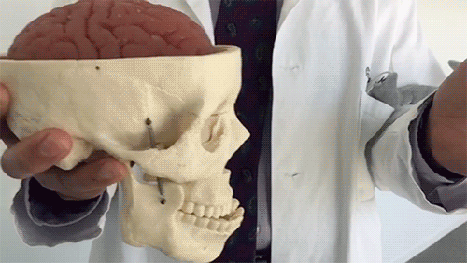
Biomechanics
2 mechanisms of injury (McAllister, 2011)
Contact forces
Coup injury
Immediate site of injury
Inertial Forces
Contrecoup injury
Results in axonal shearing

Slide 15
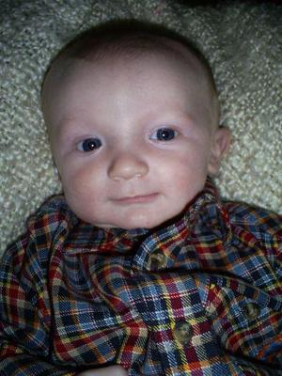
Shaken Baby Syndrome
Due to coup/contrecoup injuries
30% mortality rate, >60% survivors impaired
Subdural and retinal hemorrhages
Lethargic eyes, pale blue skin
Diffuse Axonal Damage

Slide 16
Neuroanatomy

Slide 17
Two Phases of Damage
Primary Phase
Mechanical damage
Typically Bleeding
Secondary Phase
Diffuse damage
Blood Brain Barrier compromised
White matter damage

Slide 18
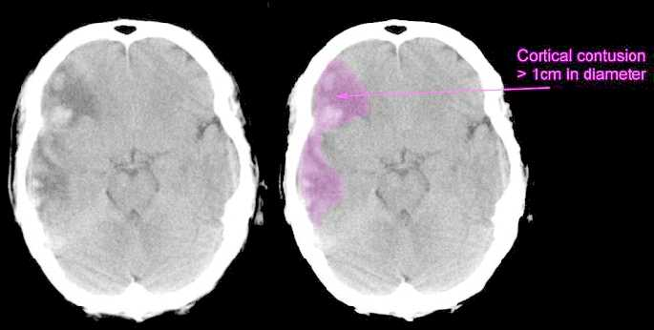
Primary Damage - Contusions
Bruising of the brain
Damage to gray matter
Inflammatory response

Slide 19
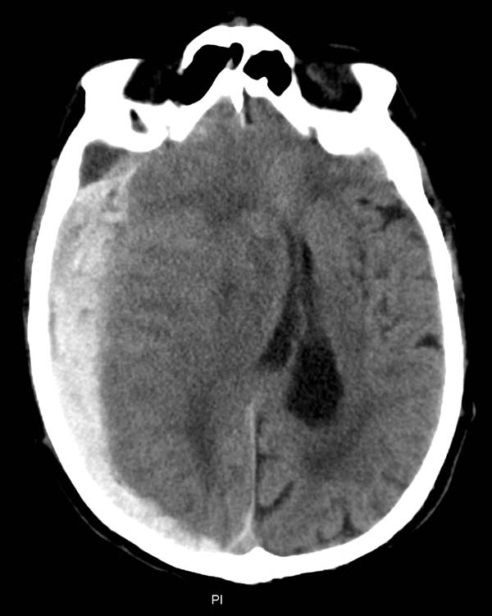
Primary Damage – Subdural Hematoma
Rupture of a subdural blood vessel
Result of inertial forces
Gray matter damage by means of ischemia
Increase intracranial pressure (ICP)

Slide 20
Secondary Damage - Cerebral Edema
Swelling of the brain leading to increased brain volume and increased Intracranial Pressure (ICP) (Unterberg et al., 2004)
Specifically, Increase in water volume in the brain (Iffland II, Grant & Janigro, 2014)
Two main types:
Vasogenic Edema– capillary leakage
Cytotoxic Edema – cellular swelling
Surprisingly no hydrocephalic edema resulting from concussion (Unterberg et al., 2004)

Slide 21
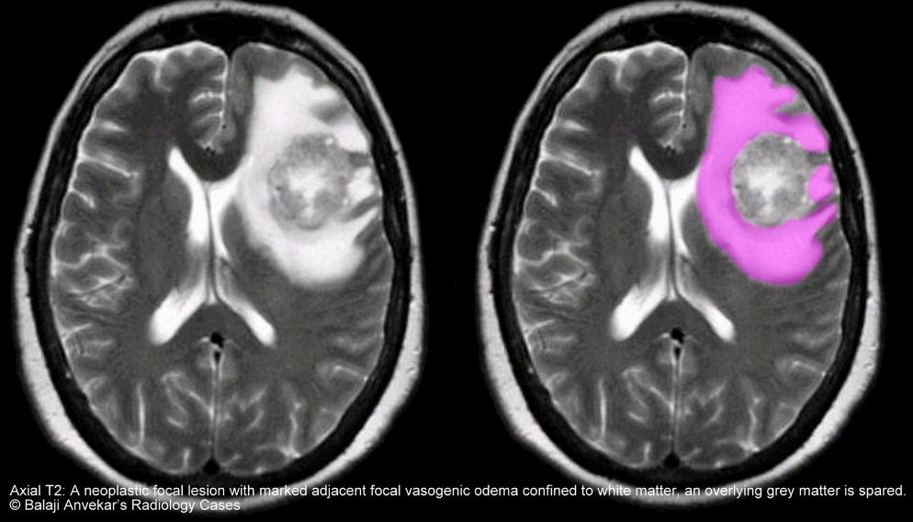
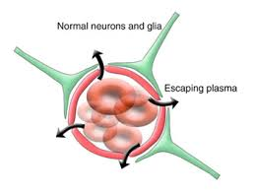
Vasogenic Edema
Caused by leakage of blood vessels
Increases vascular permeability of Blood/Brain Barrier
Increased vulnerability of brain
Ischemia in swollen areas
Can cause herniation and peripheral damage

Slide 22
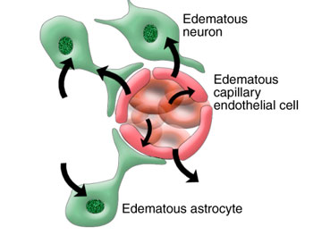
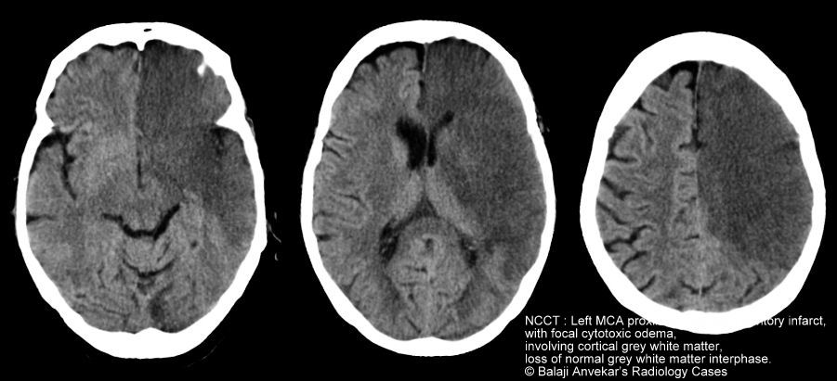
Cytotoxic Edema
Increase in cell volume due to change in intracellular osmotic balance
Blood/brain barrier intact
Leads to Necrosis of grey matter

Slide 23
From Iffland II, Grant & Janigro (2014)

Slide 24
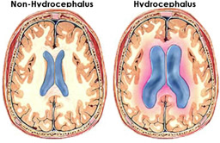
Secondary Damage – Posttraumatic Hydrocephalus
Result of subarachnoid hemorrhage (van Gijn et al., 2012)
Ventricles enlarge

Slide 25
Pathophysiology

Slide 26
The Neurometabolic Cascade of Concussion
2 main phases
Primary phase – acute trauma
Secondary phase – chronic trauma

Slide 27
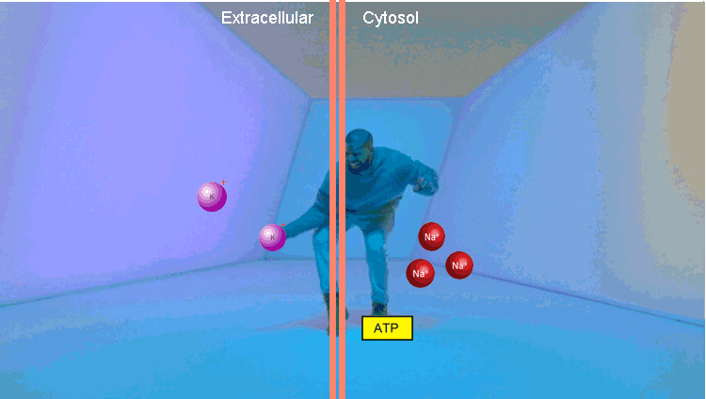
Primary phase
Immediate to hours after initial trauma
Increased level of excitatory neurotransmitters binding to NMDA receptors (Giza & Hovda, 2001)
Necrosis by excitotoxicity
Hyperglycolysis to restore resting potential
Increased vulnerability of the brain

Slide 28
Secondary Phase
Hours to days after initial trauma
Decrease in metabolism and Cerebral Blood Flow (CBF) (Weber, 2012)
Accumulation of Calcium in cells (McAllister, 2011)
Necrosis due to excitotoxicity
Mitochondrial release of Reactive Oxygen Species (ROS) (Slemmer et al, 2008)
Neuroinflammation
Stimulation of proinflammatory cytokines by astrocytes and microglia
Apoptosis due to cellular morphological change
Neurotropic Factors decrease rate

Slide 29
From McAllister (2011)

Slide 30
From McAllister (2011)

Slide 31
Diffuse Axonal Injury
Occurs both in primary and secondary phase (Giza and Hovda, 2001)
Mechanical damage due to neuroanatomical and pathophysiological changes (Smith, Meaney and Shull, 2003)
Wallerian Degeneration: mass axonal and myelin degeneration
Part of axon distal to cell body disintegrates
Myelin reduces over time

Slide 33
Neuroendocrinology

Slide 34
Hypopituitarism
“Pituitary dysfunction defined by deficient production of one or more pituitary hormones at least 1 year after injury “ (Wilkinson et al., 2012)
Caused by necrosis in periphery of pituitary gland
Exact effects dependent on location of damage (Yuan & Wade, 1991)
Some degree found in 40% of patients with some form of TBI (Daniel et al., 2000)

Slide 35
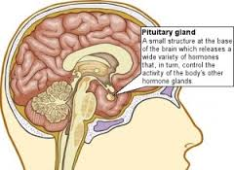
Hypopituitarism
Positive correlation with injury severity and frequency
Cognitive, emotional and developmental effects (Greco, Hovda & Prins, 2013)
Growth Hormone Deficiency
Lack of hormones in amygdala, putamen, prefrontal cortex
Largely undiagnosed and undertreated (Gasco et al., 2010)

Slide 36
Assessment

Slide 37
Difficulties in Assessment
Clinicians and Researchers employ scales and neuroimaging when assessing TBI
Secondary phase trauma extends over time
Scales ambiguous due to lack of operational definitions
Neuroimaging is correlative not causational

Slide 38
Severity Scales – Glasgow Coma Scale (GCS)
Assess level of responsiveness in patient with acute brain damage
3 factors: (1) eye opening, (2) best motor response, (3) best verbal response
Scored 1-15 for severity of damage
Pediatric Coma Scale
From Wright (2011)

Slide 40
Mini-Mental State Exam
Evaluation of cognitive impairment
5 areas of cognition examined:
orientation, registration, attention and calculation, recall and language
<23/30 means patient suffering from cognitive impairment
“What year/season/day/month is it?”
“Copy this design”

Slide 41
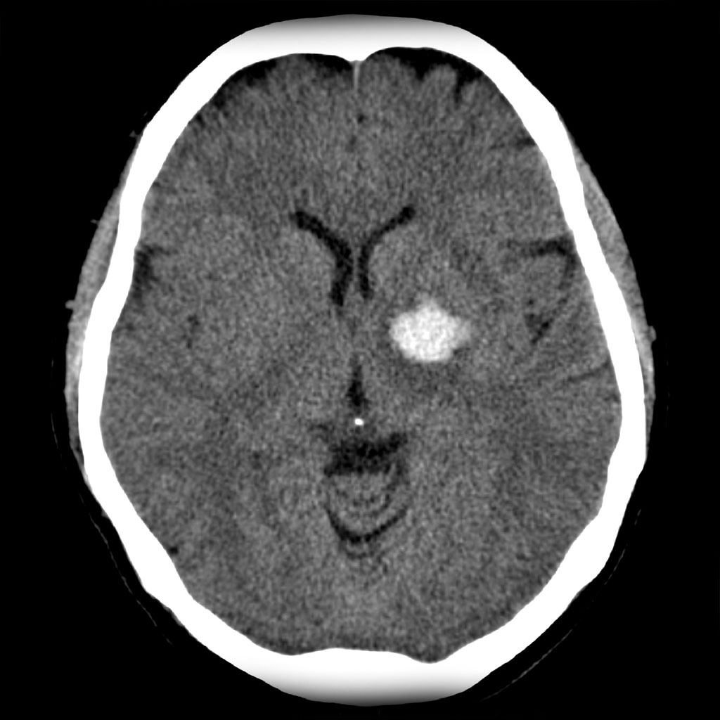
Neuroimaging – Computed Tomography (CT)
Most common form of neuroimaging for TBI
Used for acute intracranial injury and skull fracture

Slide 42
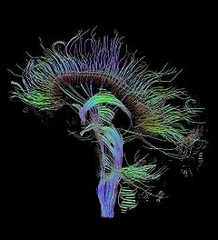
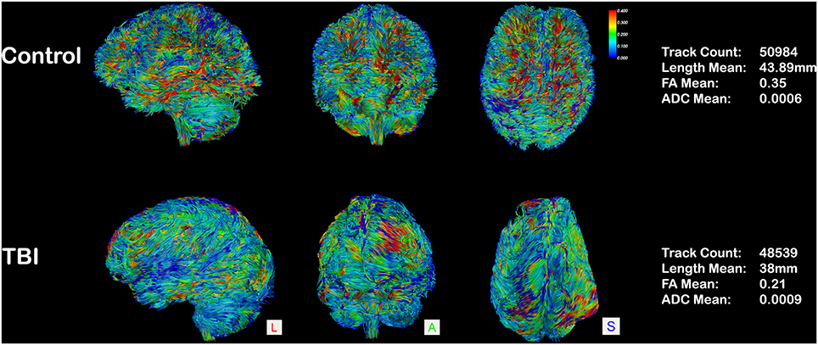
Neuroimaging – Diffusion Tensor Imaging
Measures diffusion of water in particular direction along a membrane
Excellent at determining connectivity

Slide 43
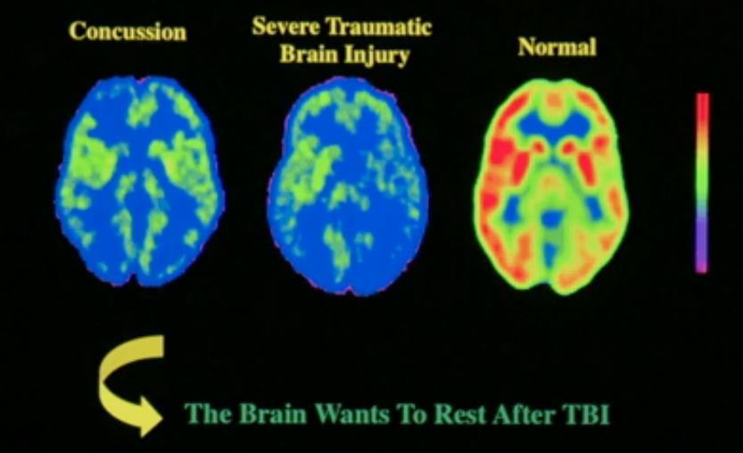
Neuroimaging – Positron Emission Tomography
Uses radioisotopes injected into metabolic compounds such as glucose
Good at assessing metabolic activity
Used for patients with severe TBI

Slide 44
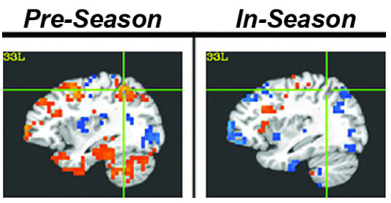
Neuroimaging- Functional Magnetic Resonance Imaging (fMRI)
Looks at deoxygenated hemoglobin levels in the blood
Scans can be taken in very close intervals
Easily detects contusions, hemorrhages, edema, etc

Slide 45
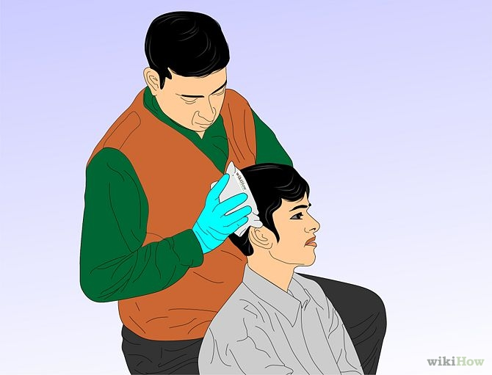
Treatment
Little published research on treatment for concussion
Symptoms get better over time
Evaluate as soon as possible

Slide 46
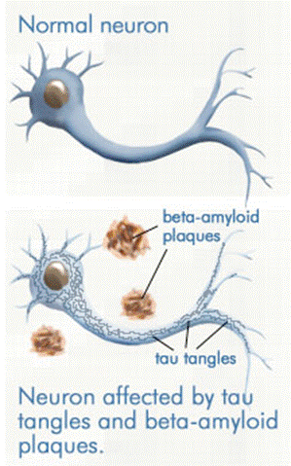
Treatment
REST!!!
Chronic Traumatic Encephalopathy
Build up of Tau Proteins (Gavett et al., 2010).
Neurofibrillary tangles
Loss of cognition, mood and personality changes
Leads to eventual dementias
Second Impact Syndrome
Consecutive concussions without healing
Fatal

Slide 47
Treatment
Medication
Treat symptoms
Hormone Replacement Therapy (Moreau et al., 2013; High Jr. et al., 2010)
NMDA Antagonist (Panter and Faden, 1992)
Cognitive rehabilitation
Moderate Hypothermia (Marion et al., 1997)

Slide 48
Recovery and Neuroplasticity

Slide 49
Recovery
Mild concussions recover in approximately 3 weeks
Post-concussive syndrome – symptoms lingering after 3 weeks
Recovery dependant on severity and frequency of trauma
Recovery and plasticity influenced by environment and learning
Post-concussive vulnerability period (Giza & DiFiori, 2010)
Difficult to assess

Slide 50
Anatomical Neuroplasticity
Complete restoration and structural recovery impossible
Gliosis
Calcification
Some neurogenesis possible in certain areas
Subventricular Zone, Hippocampus, Hypothalamus (Cheng, 2013)
Microglial Involvement:
Microglia responsible for expression of synaptophysin and neuritogenesis (Madinier et al., 2009)
Compensation in peripheral areas
3 compensation areas (Nudo, 2006)

Slide 51
Cognitive Neuroplasticity
Basis of recovery – Brain Derived Neurotropic Factors
Stimulate synaptogenesis and maintenance/recovery of damaged cells
Enriched environment increases cognitive performance in rats
Individual factors
de Krujik et al. (2002): 72% ‘fully’ recovered, 28% did not
Age differences
Window of youth in rats (Prins & Hovda, 2009)

Slide 52
Comorbidity
Mood disorders
MDD and GAD symptoms for mild TBI (Guskiwicz et al, 2006; Fann et al., 2004)
Location dependent
Unclear reasons for root cause
Significant increase in suicide rates
Substance abuse (Corrigan, 1995)
Typically for mild TBI and in males
TBI patients exhibit greater alcohol abuse patterns than national average (Corrigan, Rust & Lamb-Hart, 1995)
Unclear reasons
Alzheimer’s Disease, Parkinson’s, Huntingdon’s
Due to neurodegeneration
Epilepsy
Risk approaching 50% (Lowenstein, 2009).

Slide 53
Conclusion
Legal Issues
Regulation of sports equipment
“Back to training” policies
Need for concise definition
Will allow for better diagnosis and treatment

Slide 54
References
Anderson, T., Heitger, M., Macleod, A. D. (2006). Concussion and mild head injury. Practical Neurology. 6(6):342-357. doi:10.1136/jnnp.2006.106583
Battinn, B., Cobb, S. (2004). Second-impact syndrome. Journal of School Nursing. 20(5): 262-267. doi: 10.1177/10598405040200050401
Belanger, H. G., Vanderploeg, R. D., Curtiss, G., Warden, D. L. (2007). Recent neuroimaging techniques in mild traumatic brain injury. The Journal of Neuropsychiatry and Clinical Neurosciences. 19(1): 5-20. Retrieved November 15, 2015 from: http://neuro.psychiatryonline.org/doi/10.1176/jnp.2007.19.1.5
Beuche, W., Friede, R. L. (1984). The role of non-resident cells in wallerian degeneration. Journal of Neurocytology. 13(5): 767-796. doi: 10.1007/BF01148493
Bruns Jr., J., Hauser, A. W. (2003). The epidemiology of traumatic brain injury: a review. Epilepsia. 44(10): 2-10. Retrieved November 11, 2015 from: http://onlinelibrary.wiley.com/doi/10.1046/j.1528-1157.44.s10.3.x/pdf
Burton, M. S. (2011). Long-term treatment of concussion. In Pediatric and Adolescent Concussion. 1:107-115. Retrieved November 11, 2015 from: http://link.springer.com/chapter/10.1007%2F978-0-387-89545-1_9
Cervos-Navarro, J., Laufuente, J. V. (1991). Traumatic brain injuries: structural changes. Jounral of the Neurological Sciences. 103: 3-14. doi: http://dx.doi.org/10.1016/0022-510X(91)90002-O.
Cheng, M. F. Hypothalamics neurogenesis in the adult brain. Frontiers in Neuroendocrinology. 34(3):167-178. doi:10.1016/j.yfrne.2013.05.001
Chodobski, A., Zink, J. B., Szymydynger-Chodobska, J. (2013). CNS barriers in neurotrauma in Vascular Mechanisms in CNS Trauma. 5(1): 3-28. doi: 10.1007/978-1-4614-8690-9_1
Concussion. 2014. In mayoclinic.org. Retrieved November 11, 2015 from: http://www.mayoclinic.org/diseases-conditions/concussion/basics/definition/con-20019272
Corrigan, J. D. (1995). Substance abuse as a mediating factor in outcome from traumatic brain injury. Archives of Physical Medicine and Rehabilitation. 76(4): 302-309. doi: http://dx.doi.org/10.1016/S0003-9993(95)80654-7
Corrigan, J. D., Rust, E., Lamb-Hart, G. L. (1995). The nature and extent of substance abuse problems in persons with traumatic brain injury. Journal of Head Trauma Rehabilitation. 10(3). Retrieved November 11, 2015 from: http://journals.lww.com/headtraumarehab/Abstract/1995/06000/The_nature_and_extent_of_substance_abuse_problems.4.aspx
Dahab, K. S., Bernhardt, D. T. (2011). Utilization of Imaging Technology in Concussion Assessment. In Pediatric and Adolescent Concussion. 1:81-91. Retrieved November 11, 2015 from: http://link.springer.com/chapter/10.1007%2F978-0-387-89545-1_7
Fann, J. R., Burnington, B., Leonetti, A., Jaffe, K., Katon, W. J., Thompson, R. S. (2004). Psychiatric illness following traumatic brain injury in an adult health maintenance organization population. Archives of General Psychiatry. 61(1):53-61. doi:10.1001/archpsyc.61.1.53.
Freco, T., Hovda, D., Prins, M. (2013). The effects of repeat traumatic brain injury on the pituitary in adolescent rats. Journal of Neurotrauma. 30(23): 1983-1990. doi:10.1089/neu.2013.2990.
Gage, F. H. (2002). Neurogenesis in the adult brain. The Journal of Neuroscience. 22(3): 612-613. Retrieved November 14, 2015 from: http://www.jneurosci.org/content/22/3/612.short
Gasco, V., Prodam, F., Pagano L., Grottoli, S., Belcastro, S., Marzullo, P., Beccuti, G., Ghino, E., Aimaretti, G. (2010). Hypopituitarism following brain injury: when does it occur ad how best to test? Pituitary. 15(1): 20-24. Retrieved November 11, 2015 from: http://link.springer.com/article/10.1007/s11102-010-0235-6#/page-1
Gavett, B. E., Stern, R. A., Cantu, R. C., Nowinski, C. J., McKeel, A. C. (2010). Mild traumatic brain injury: a risk factor for neurodegeneration. Alzheimer’s Research and Therapy. 2(18). doi:10.1186/alzrt42
Gennarelli, T., Thibault, L. (1982). Biomechanics of acute subdural hematoma. Journal of Trauma-Injury, Infection and Critical Care. 22(8). Retrieved November 17, 2015 from: http://journals.lww.com/jtrauma/Abstract/1982/08000/Biomechanics_of_Acute_Subdural_Hematoma.5.aspx
Gijn, J. V., Hijdra, A., Wijdicks, E. F. M., Vermeulen, M., van Crevel, H. (2012). Acute hydrocephalus after aneurysmal subarachnoid hemorrhage. Journal of Neurosurgery. 116(5): 335-362. Retrieved November 11, 2015 from: http://thejns.org/doi/abs/10.3171/jns.1985.63.3.0355@col.2012.116.issue-5

Slide 55
References - continued
Giza, C. C., DiFiori, J. P. (2010). Pathophysiology of sports-related concussion: an update on basic science and translational research. Sports Health: A Multidisciplinary Approach. 3(1):46-51. doi: 10.1177/1941738110391732
Giza, C. C., Griesbach, G. S., Hovda, D. A. (2005). Experience-dependent behavioral plasticity is disturbed following traumatic injury to the immature brain. Behavioral Brain Research. 157(1): 11-22. doi:10.1016/j.bbr.2004.06.003
Giza, C. C., Hovda, D. A. (2001). The neurometabloic cascade of concussion. Journal of Athletic Training. 36(3): 228-235. Retrieved November 11, 2015 from: http://www.ncbi.nlm.nih.gov/pmc/articles/PMC155411/
Graham, R., Rivara, F. P., Ford, M. A. et al. (ed). (2014) Committee on Sports-Related Concussions in Youth. USA: Washington (DC): National Academies Press.
Griesbacha, G. S., Hovda, D. A., Moltenic, R., Wuc, A., Gomez-Pinillaa, F. (2004). Voluntarry exercise following traumatic brain injury: brain-derived neurotrophic factor upregulation and recovery of function. Neuroscience. 125(1):129-139. doi:10.1016/j.neuroscience.2004.01.030
Guskiewicz, K. M., Marshal, S. W., Bailes, J., McCrea, M., Harding Jr., H. P., Matthews, A., Mihalik, J. R., Cantu, R. C. (2007). Recurrent concussion and risk of depression in retired professional football players. Medicine and Science in Sports and Exercise. 39(6): 903-909. Retrieved November 11, 2015 from: http://www.ncbi.nlm.nih.gov/pubmed/17545878
High Jr., W. M., Briones-Galang, M., Clarke, J. A., Gilkison, C., Mossberg, K. A., Zgaljardic, D. J., Masel, B. E., Urban, R. J. (2009). Effects of growth hormone replacement therapy on cognition after traumatic brain injury. Journal of Neurotrauma. 27(9): 1565-1575. doi:10.1089/neu.2009.1253.
Holmin, S., Sodurlund, J., Biberfeld, P., Mathiesen, T. (1998). Intracerebral inflammation after human brain contusion. Neurosurgery. 42(2):291-298. Retrieved November 17, 2015 from: http://journals.lww.com/neurosurgery/Abstract/1998/02000/Intracerebral_Inflammation_after_Human_Brain.47.aspx
Huebner, E. A., Strittmatter, S. M. (2009). Axon regeneration in the peripheral and central nervous systems. Results and Problems in Cell Differentiation. 48: 339-351. doi: 10.1007/400_2009_19
Iffland II., P. H. Grant, G. A., Janigro, D. (2013). Mechanisms of cerebral edema leading to early seizures after traumatic brain injury. In Vascular Mechanisms in CNS Trauma. 5(1): 29-45. doi: 10.1007/978-1-4614-8690-9_1.
Jorge, R. E., Robinson, R. G., Starkstein, S. E., Arndt, S. V. (1993). Depression and anxiety following traumatic brain injury. The Journal of Neuropsychiatry and Clinical Neurosciences. 5(4)369-374. Retrieved November 11, 2015 from: http://psycnet.apa.org/psycinfo/1994-18234-001
Kelly, D. F., Gonzalo, I. T. G., Cohan, P., Berman, N., Swerdloff, R., Wang, C. (2000). Hypopituitarism following traumatic brain injury and aneurysmal subarachnoid hemorrhage: a preliminary report. Journal of Neurosurgery. 93(5): 743-752. Retrieved November 11, 2015 from: http://thejns.org/doi/abs/10.3171/jns.2000.93.5.0743
Kelly, D. F., McArthur, D. L., Levin, H., Swimmer, S., Dusick, J. R., Cohan, P., Wang, C., Swerdloff, R. (2006). Neurobehavioral and quality of life changes associated with growth hormone insufficiency after complicated mild, moderate or severe traumatic brain injury. Journal of Neurotrauma. 23(6): 928-942. doi:10.1089/neu.2006.23.928.
Kleim, J. A., Jones, T. A. (2008). Principles of experience-dependent neural plasticity: implications for rehabilitation after brain damage. Journal of Speech, Language and Hearing Research. 51: 225-239. doi:10.1044/1092-4388(2008/018)
Kou, Z., Haacke, M. E. (2014). Advanced neuroimaging of mild traumatic brain injury. In Concussions in Athletics. 3: 217-234. doi 10.1007/978-1-4939-0295-8_12.
Kraus, J. F., McArthur, D. L. (2006). Epidemiology of brain injury. In Neurology and Trauma. Pp. 3-18. Retrieved November 11, 2015 from: https://books.google.ca/books?hl=en&lr=&id=ASu9Kf8g-54C&oi=fnd&pg=PA3&dq=socioeconomic+status+and+tbi&ots=ECw6pp-O2t&sig=NF5nkPABWWLs9pFHISL2vBuCSYo#v=onepage&q=chapter%202&f=false
de Kruijk, J. R., Leffers, P., Menheere, P. P. C. A., Meerhoff, S., Rutten, J., Twijnstra, A. (2002). Prediction of post-traumatic complaints after mild traumatic injury: early symptoms and biochemical markers. Journal of Neurology, Neurosurgery and Psychiatry. 73: 727-732.

Slide 56
References - Continued
Kurlowicz, L., Wallace, M. (1999). The mini mental state examination (MMSE). Hartford Institute for Geriatric Nursing. 1(3). Retrieved November 15, 2015 from: https://www.mountsinai.on.ca/care/psych/on-call-resources/on-call-resources/mmse.pdf
Lowenstein, D. H. (2009). Epilepsy after head injury: an overview. Epilepsia. 2(1): 4-9. doi:10.1111/j.1528-1167.2008.02004.x.
Madinier, A., Bertrand, N., Mossiat, C., Prigent-Tessier, A., Beley, A., Marie, C., Garnier, P. (2009). Microglial involvement in neuroplastic changes following focus brain ischemia in rats. PLoS ONE. 4(12): e8101. doi:10.1371/journal.pone.0008101
Marion, D. W., Penrod, L. E., Kelsey, S. F., Obrist, W. D., Kochanek, P. M., Palmer, A. M., Wisniewski, S. R., DeKosky, S. T. (1997). Treatment of traumatic brain injury with moderate hypothermia. The New England Journal of Medicine. 336: 540-546. Retrieved November 11, 2015 from: http://www.nejm.org/doi/full/10.1056/nejm199702203360803#t=articleDiscussion
Matschke, J., Herrmann, B., Sperhake, J., Kober, F., Bajanowski, T., Glatzel, M. (2009). Shaken baby syndrome: a common variant of non-accidental head injury in infants. Deutsches Ärzteblatt International. 106(13): 211–7. doi: 10.3238/arztebl.2009.0211
McAllister, T. W. 2011. Neurobiological consequences of traumatic brain injury. Dialogues in Clinical Neuroscience. 13(3): 287-300. Retrieved November 11, 2015 from http://www.ncbi.nlm.nih.gov/pmc/articles/PMC3182015/
Menon, D. K., Schwab, K., Wright, D. W., Maas, A. I. (2010). Position statement: definition of traumatic brain injury. Archives of Physical Medicine and Rehabilitation. 91(11):1637-40. doi: 10.1016/j.ampr.2010.05.017.
Moreau, O. K., Cortet-Rudelii, C., Yollin, E., Merlen, E., Daveluy, W., Rousseuax, M. (2013). Growth hormone replacement therapy in patients with traumatic brain injury. Journal of Neurotrauma. 30(11):998-1006. doi:10.1089/neu.2012.2705
Nudo, R. J. (2006). Plasticity. NeuroRx. 3(4):420-427. doi: 10.1016/j.nurx.2006.07.006.
Ogden, J. A. (2005). Functional Neuroanatomy in Fractured Minds: A Case-Study Approach to Clinical Neuropsychology. 2nd ed. Pp. 6-43. USA: Oxford University Press. Retrieved November 11, 2015 from: http://kopinska.apps01.yorku.ca/4080/Fractured_Neuroanatomy.pdf
Ownsworth, T. L., Oei, T. P. A. (1998). Depression after traumatic brain injury: conceptualization and treatment considerations. Brain Injury. 12(9): 735-751. doi:10.1080/026990598122133
Pangilinan Jr. P. H. (2015). Posttraumatic hydrocephalus. From emedicine.medscape.com. Retrieved November 11, 2015 from (http://emedicine.medscape.com/article/326411-overview)
Panter, S. S., Faden, A. I. (1992). Pretreatment with NMDA antagonists limits release of excitatory amino acids following traumatic brain injury. Neuroscience Letters. 136(2):165-168. doi:10.1016/0304-3940(92)90040-E
Prins, M. L., Hovda, D. A. (2009). The effects of age and ketogenic diet on local cerebral metabolic rates of glucose after controlled cortical impact injury in rats. Journal of Neurotrauma. 26(7): 1083-1093. doi: 10.1089/neu.2008.0769
Roozenbeek, B., Maas, A. I. R., Menon, D. K. (2013). Changing patterns in the epidemiology o traumatic brain injury. Nature Reviews Neurology. 9: 231-236. doi:10.1038/nrneurol.2013.22

Slide 57
References - Continued
Sawauchi, S., Marmarou, A., Beaumont, A., Signoretti, S., Fukui, S. (2004). Acute subdural hematoma associated with diffuse brain injury and hypoxemia in the rat: effect of surgical evacuation of the hematoma. Journal of Neurotrauma. 21(5): 563-573. doi:10.1089/089771504774129892.
SCAT3. (2015). From bjsm.bmj.com. Retrieved November 11, 2015 from: http://bjsm.bmj.com/content/47/5/259.full.pdf
Second Impact Syndrome. From brainandspinalchord.org. Retrieved November 17, 2015 from: http://www.brainandspinalcord.org/traumatic-brain-injury-types/second-impact-syndrome/index.html
Shulman, K., Martin, B. F., Popoff, N., Ransohoff, J. (1963). Recognition and treatment of hydrocephalus following spontaneous subarachnoid hemorrhage. Journal of Neurosurgery. 20(12): 1040-1049. Retrieved November 11, 2015 from: http://thejns.org/doi/abs/10.3171/jns.1963.20.12.1040
Slemmer, J. E., Shacka, J. J., Sweeny, M. I., Weber, J. T. (2008). Antioxidants and free radical scavengers for the treatment of stroke, traumatic brain injury and aging. Current Medicinal Chemistry. 15(4):404-414. doi: 10.2174/092986708783497337
Strauss, L. B. (2013). Maddock’s questions test for Concussion on sports sideline. From momstream.com. Retrieved November 11, 2015 from: http://www.momsteam.com/health-safety/sports-concussion-safety/concussion-recognition-evaluation/maddocks-questions-test-concussion
Taylor, L. A., Kreutzera, J. R., Demma, S. R., Meadea, M. A. (2003). Traumatic brain injury and substance abuse: a review and analysis of the literature. Neuropsychological Rehabilitation. 13(1-2):165-188). doi:10.1080/09602010244000336
Thomas, D. G. (2011). Acute treatment of concussion. In Pediatric and Adolescent Concussion. 1:73-80. Retrieved November 11, 2015 from: http://link.springer.com/chapter/10.1007%2F978-0-387-89545-1_6
Thornton, K. E. (2014). The role of the quantitative EEG in the diagnosis and rehabilitation of the traumatic brain injured patients. In Concussions in Athletics. 3: 245-361. doi 10.1007/978-1-4939-0295-8_12.
Unterberg, A. W., Stober, J., Kressc, B., Kieniga, K L. (2004). Edema and brain trauma. Neuroscience. 129(4): 1019-1027. doi:10.1016/j.neuroscience.2004.06.046
Wasserman, L., Shawa, T., Vub, M., Koc, C., Bollegalaa, D., Bhalerao, S. (2008). An overview of traumatic brain injury and suicide. Brain Injury. 22(11): 811-819. doi:10.1080/02699050802372166
Wilkinson, C., Pagulaya, K., Colasurdo, E., Shofer, J., Peskind, E. (2012). Blast concussion is associated with high frequency of pituitary dysfunction. Endocrine Abstracts. 29: 1436. Retrieved November 11, 2015 from: http://www.endocrine-abstracts.org/ea/0029/ea0029p1436.htm
Weber, J. T. (2012). Altered calcium signaling following traumatic brain injury. Frontiers in Pharmacology. 60(3). doi: 10.3389/fphar.2012.00060
Whyte, J. (2011). Rancho Los Amigos scale. Encyclopedia of Clinical Neuropsychology. pp. 2110. doi: 10.1007/978-0-387-79948-3_67.
Wright, J. (2011). Glasgow coma scale. Encyclopedia of Clinical Neuropsychology. pp. 1149-1150. doi: 10.1007/978-0-387-79948-3_1840.
Yi, J., Padalino, D. J., Chin, L. S., Montenegro, P., Cantu, R. C. (2013). Chronic Traumatic Encephalopathy. Current Sports Medicine Reports. 12(1):28-32. doi:10.1249/JSR.0b013e31827ec9e3
Yuan, X. Q., Wade, C. E. (1991). Neuroendocrine abnormalities in patients with traumatic brain injury. Frontiers in Neuroendocrinology. 12(3): 209-230. Retrieved November 11, 2015 from: http://www.ncbi.nlm.nih.gov/pubmed/11538874

